Slide 1

CEIR Visa Update Feature -Training Manual

Slide 2

Agenda
Feature
Stakeholder
State Diagram
UI Walk Thru
Update Visa for non-Registered User
Update Visa for Registered User
With Valid Visa
With No Visa Case

Slide 3

Feature Overview
Visa Update Feature allows end user to update their visa status in the CEIR Portal
This feature extend the device in the temporary whitelist as per the new visa dates
This feature is for foreigner user only only in case when they intend to use local SIM in their device
Typical flow is as follows:
End User (Foreigner)
Visa Update Device
End user update visa details in the CEIR portal
CEIR System

Slide 4
Visa Upload (Only for Foreigner User – First time)

Slide 5
Visa Upload (Only for Foreigner User – Second Time)

Slide 6
Feature Impact / Use Cases
Importance of this feature for the CEIR System
Extension in temporary whitelist based on the visa update.
if the user does not update the visa and devices is used, it will be blocked in the network

Slide 7
Stakeholder Overview

Slide 8
Visa Update - Flow
Key Points
Foreigner End user should already registered on the system
The visa could be there or does not exist.
In case of “default” visa, visa date to be extended to 1 month (as per configurable period) from last date of visa expiry
Update Visa
Check User Information Exist
No
Return Error
Yes
Update Visa Details
Do Visa exists
Yes
Update as per visa details
No
Update as per default period configuration
Added in Whiitelist

Slide 9
Visa Update - User Flow
End User want to update visa.
In order to update visa details , a End User needs to furnish the following details:
Passport number to identity
Visa Details
If user is not already registered, user will be asked to registered first.
System receive the request and update the whitelist as per new visa expiry dates

Slide 10
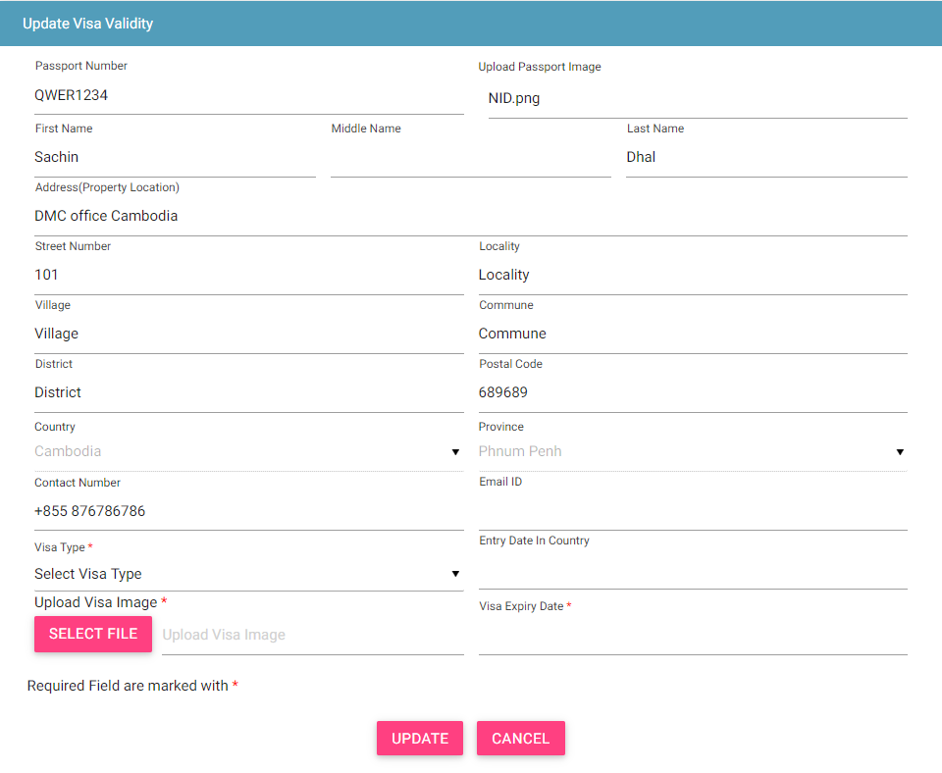
Visa Update – Registered User

Slide 11
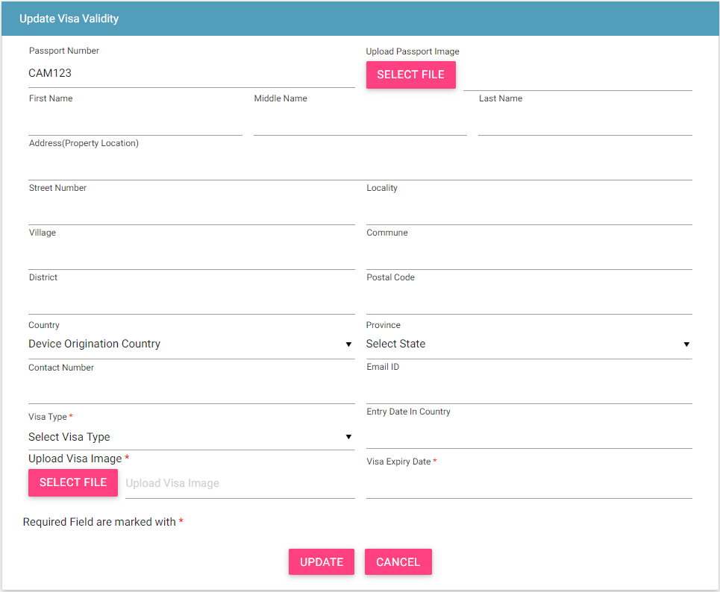
Visa Update – Non Registered User

Slide 12
Policy
There is no such policy for this feature. The only policy is that foreigner need to be informed about the same.

Slide 13
Queries

Slide 14
Thank You

